Slide 1

OUTLAND ADVENTURES
CASE STUDY
JAMES BROWN III, GABE CONNER, ALEXIS MITCHELL

Slide 2

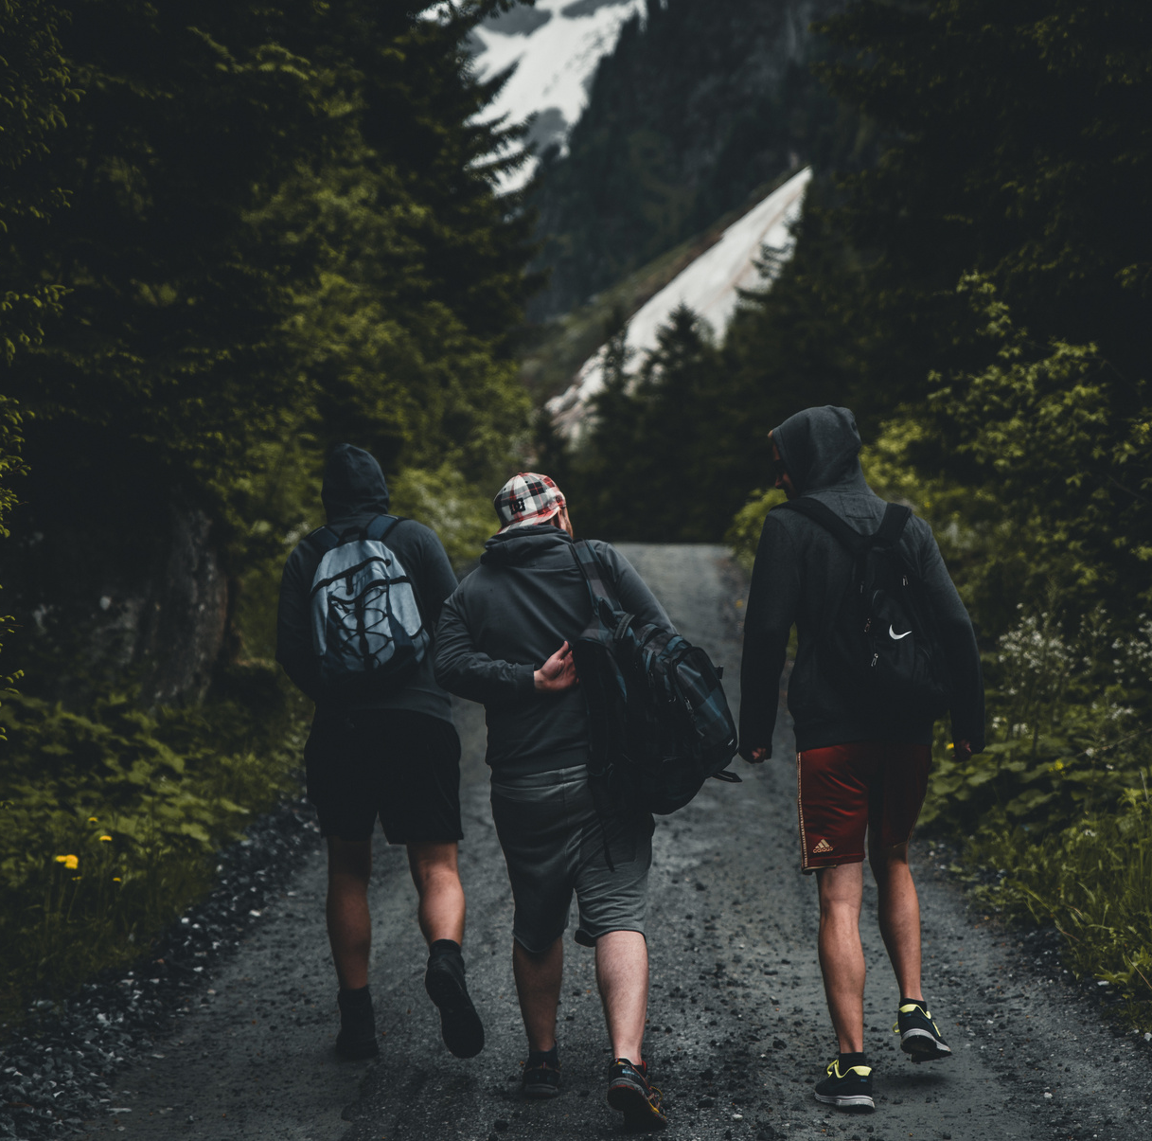
BACKGROUND
Outland Adventures is a company that organizes guided hiking and camping trips in Africa, Asia, and Southern Europe. The business provides trip planning services, equipment rentals and sales, and utilizes a digital platform for customer engagement. The company is supported by various employees in roles such as guides, marketers, inventory managers, and e-commerce developers.

Slide 3


BACKGROUND (CONT.)
The owners of Outland Adventures, Blythe Timmerson and Jim Ford, are feeling the growing pains of their fast-changing business. They’re starting to worry about more than just planning great trips. They want to know if equipment sales are still worth it, if bookings are dropping in certain regions, and if old gear is still safe to use. Their main concern is running the business efficiently and making smart choices. It’s clear they need solid data to guide their next steps.

Slide 4

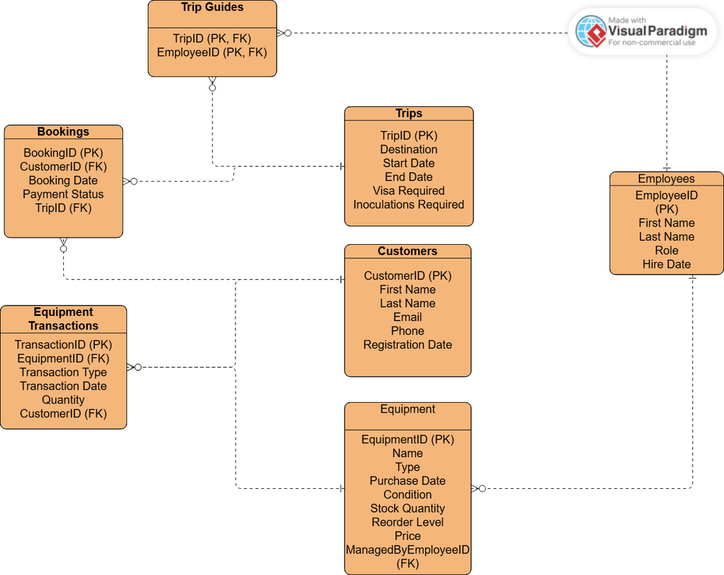
ENTITY RELATIONSHIP DESIGN

Slide 5
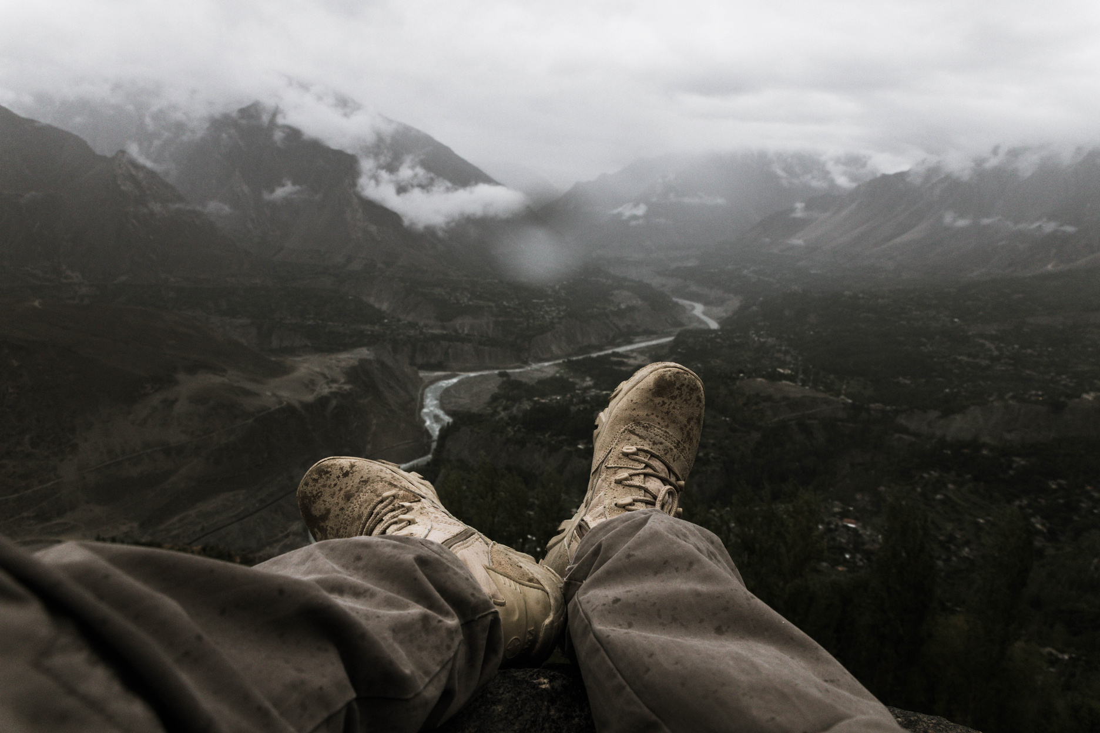
Three reports were generated based on current data stored in the company database to support ongoing operations and strategic planning at Outland Adventures. Each one of the reports was selected to highlight a different aspect of the business: customer booking trends, equipment lifecycle management, and inventory oversight.
SUMMARY OF GENERATED REPORTS

Slide 6
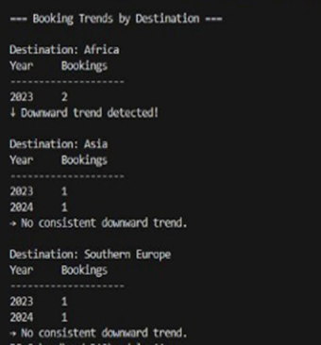
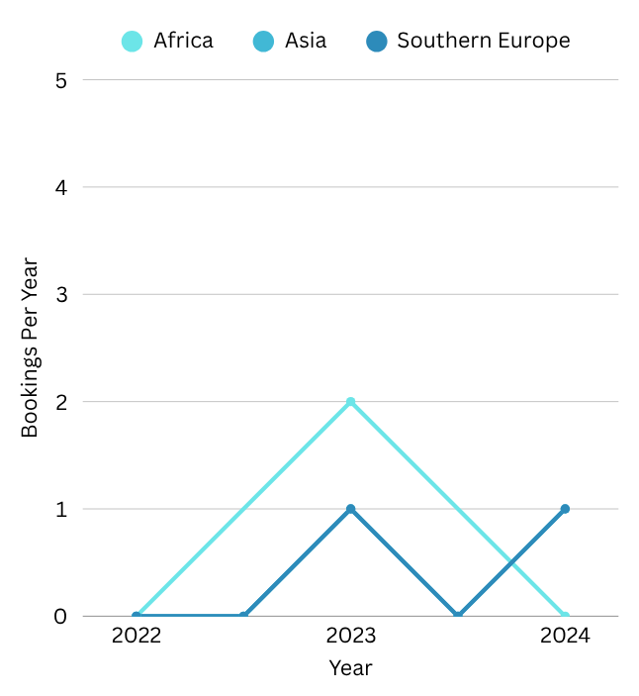
Outland Adventures has been paying close attention to how bookings shift across its destinations in Africa, Asia, and Southern Europe. By organizing reservations by year and location, we are able to get a clear view of changing travel preferences. A recent check on the data revealed a potential downward trend in popularity for one or more regions. Having this insight will help leadership decide which trips to promote or, if necessary, discontinue.
REPORT 1:
BOOKING TRENDS BY DESTINATION

Slide 7
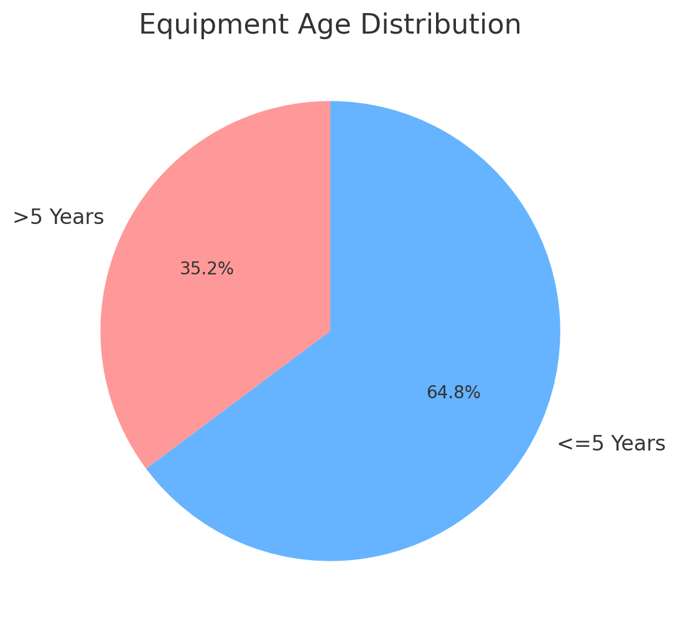
This report identifies equipment that is more than five years old and may require replacement or inspection. Regular checks like this help to ensure that the gear we use remains reliable and safe. We have found two types of equipment which have come back older than 5 years, so we will do a closer inspection to ensure they are still in good working condition. If any issues are found, we will either repair or replace the items.
REPORT 2: EQUIPMENT OVER 5 YEARS OLD

Slide 8
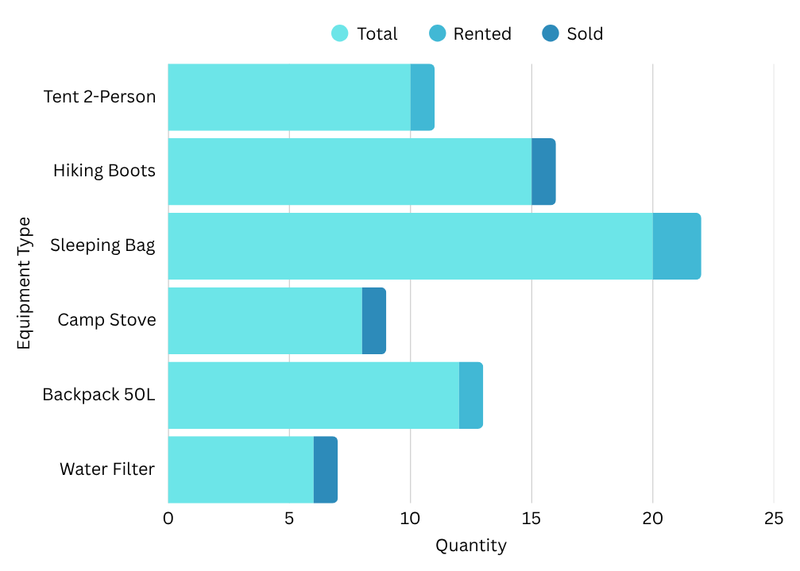
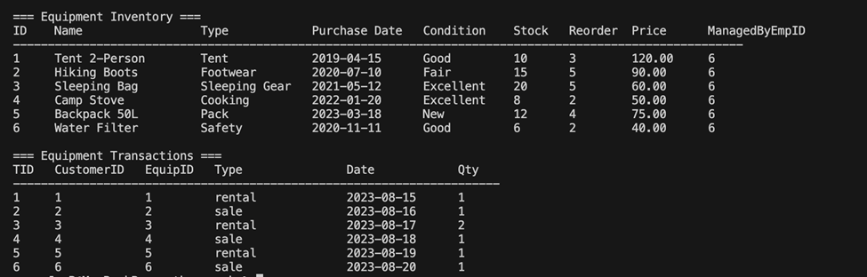
REPORT 3: EQUIPMENT INVENTORY AND TRANSACTIONS
Outland Adventures maintains a detailed inventory system for its hiking and camping equipment. Each item is tracked by a unique ID, name, type, purchase date, condition/status (available, rented, or sold), and quantity. Inventory is automatically updated when items are rented, sold, returned, or restocked. Rented items are retained for future use, while sold equipment is permanently removed from stock.

Slide 9



ASSUMPTIONS
Employees do not switch roles within the system model.
Equipment cannot be both sold and rented in one transaction.
Online and in-person transactions are tracked in the same system.
Sold equipment is removed from inventory, while rental gear is reused.
Booking frequency and regional demand are tracked.
Customers can book multiple trips and can either rent or purchase equipment.
Guides are responsible for logistical planning, including managing airfare, visas, and inoculations, and leading trips.

Slide 10

PRESENTATION
THANK YOU

